Slide 1
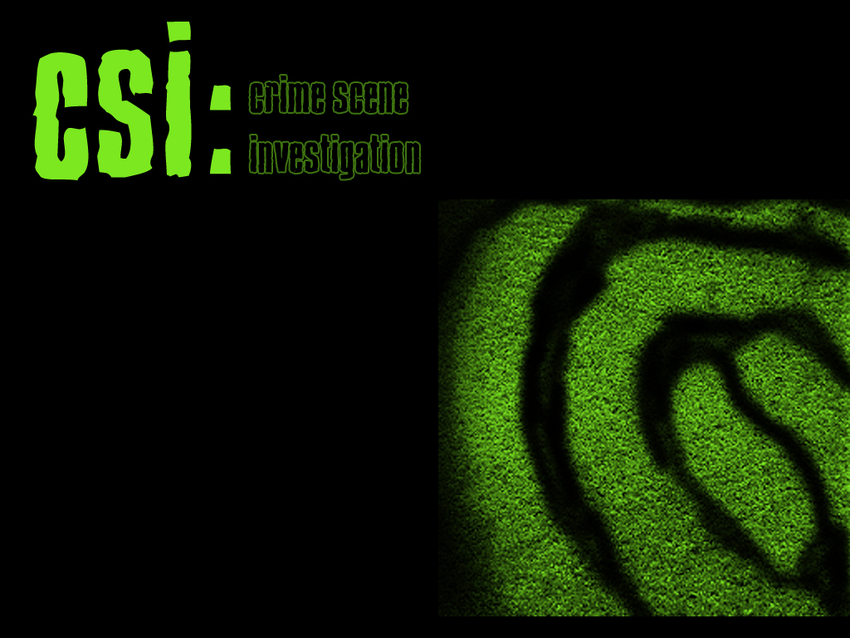
Forensic DNA Analysis
Microarrays In Action

Slide 2
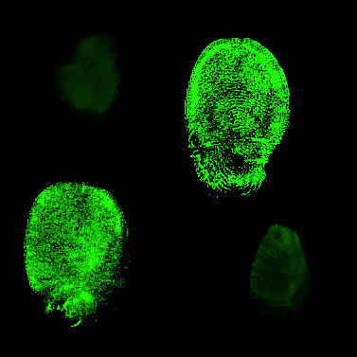
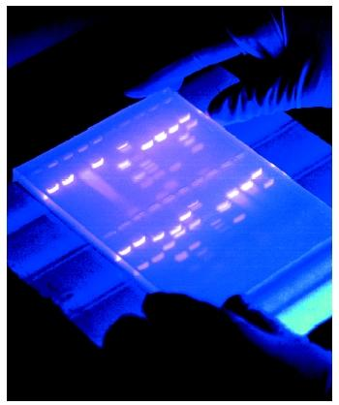
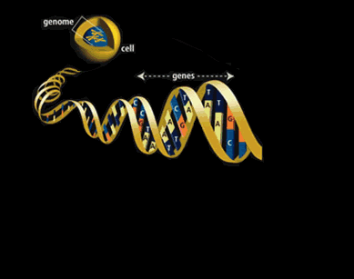
Forensic DNA Analysis
Every cell in our body contains a copy of our DNA. Our DNA can be uniquely identified in a test called the Southern Blot.

Slide 3

DNA in CSI

Slide 4
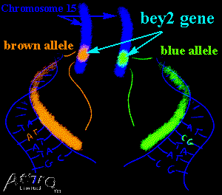
Every Base Matters
Changing just one letter in a word changes its meaning. By changing just one letter, ‘match’ can become ‘catch’, ‘patch’ or ‘batch’. Changing just one base in a gene can change things like the color of our eyes or hair.
One gene, called the bey2 gene, effects our eye color. Changing just one base can change our eyes from brown to blue.

Slide 5
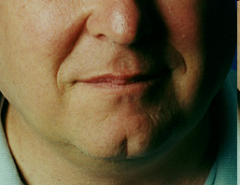
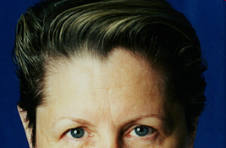

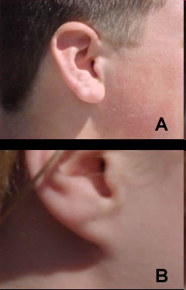
Other Traits
Cleft Chin
Widow’s Peak
Dimples
Earlobes

Slide 6
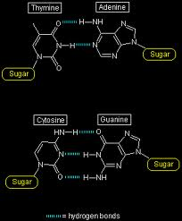
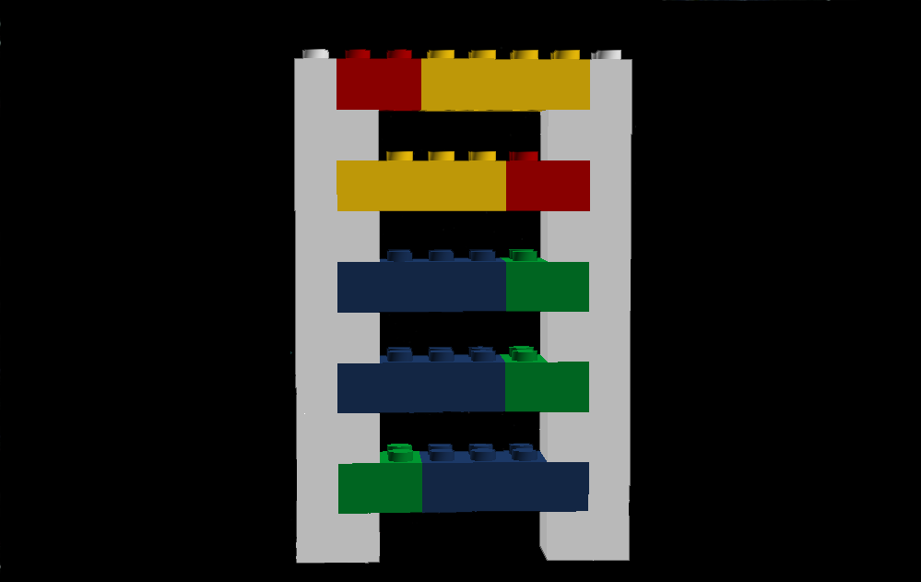
Anatomy of a Gene

Slide 7
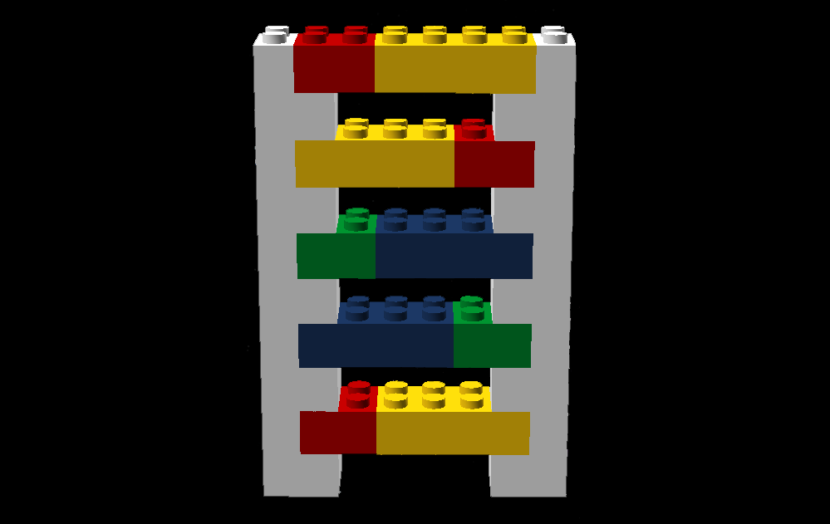
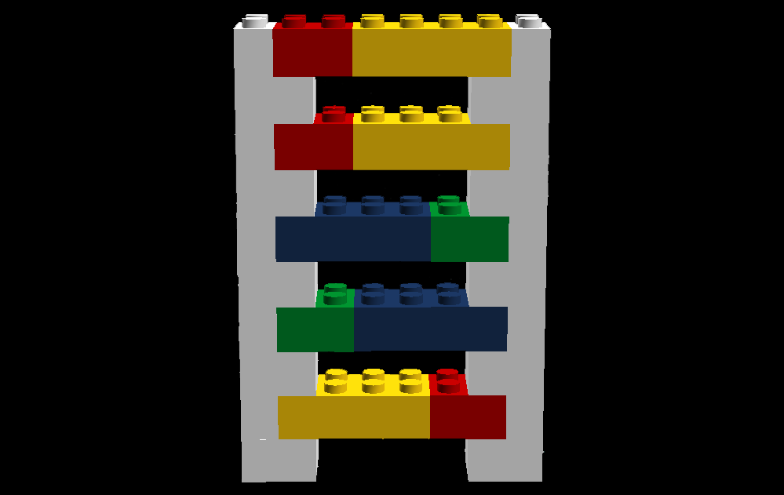
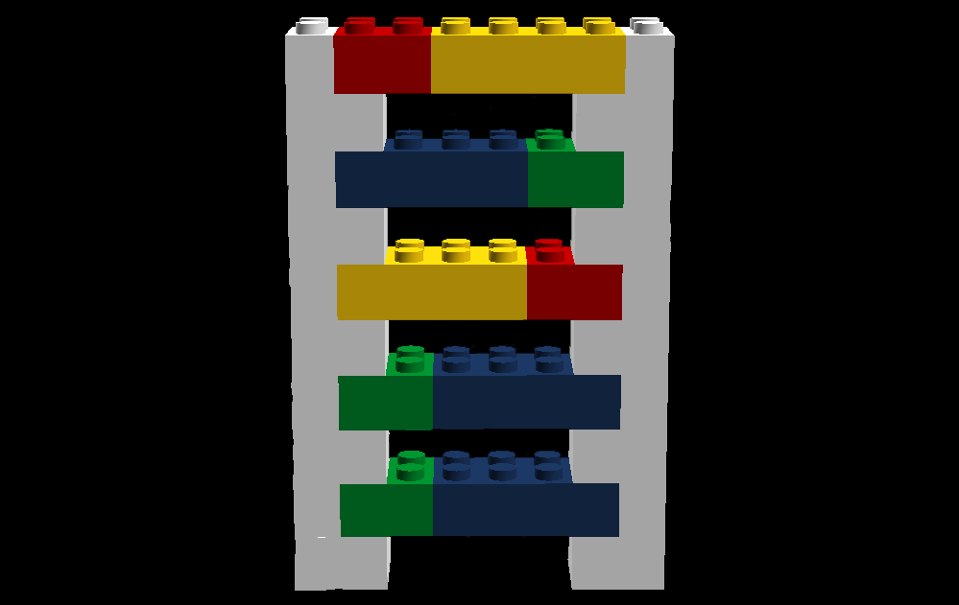
Hair Color
Blonde
Red
Brown
Black

Slide 8
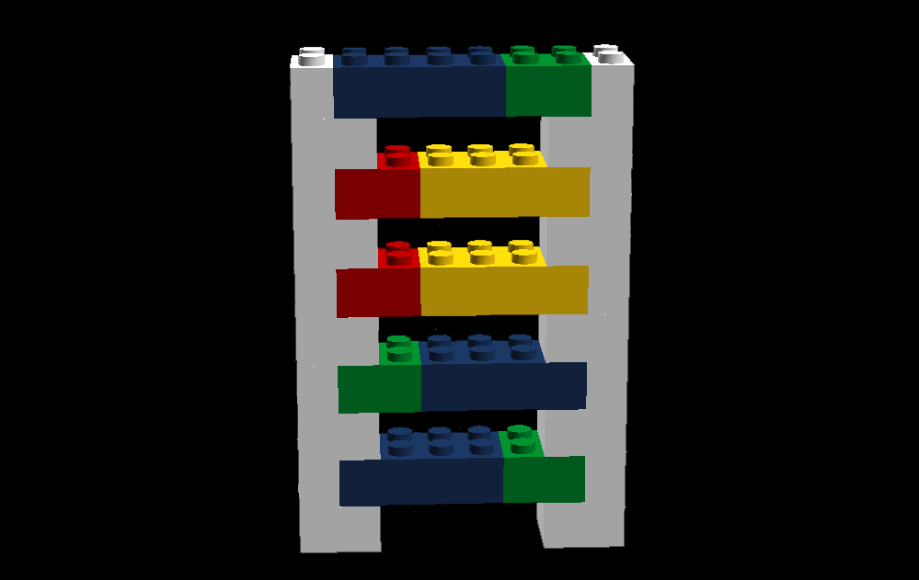
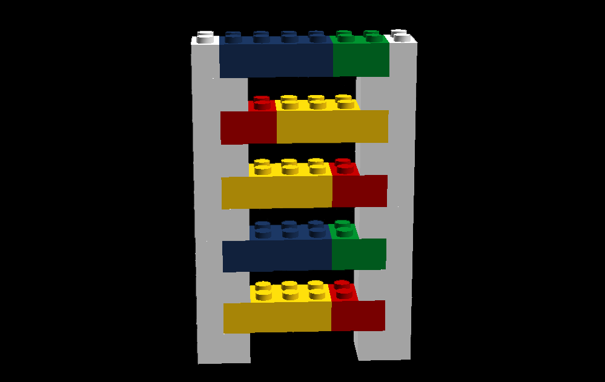
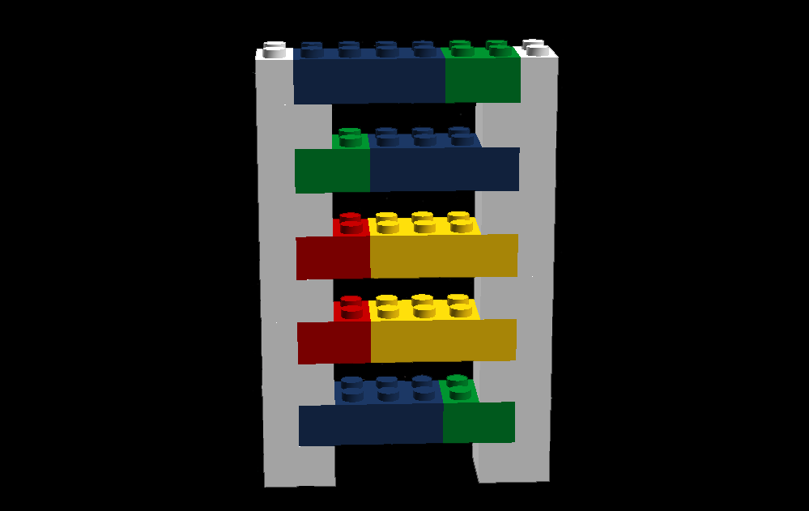
Eye Color
Blue
Green
Brown

Slide 9
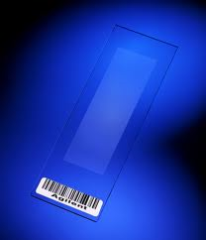
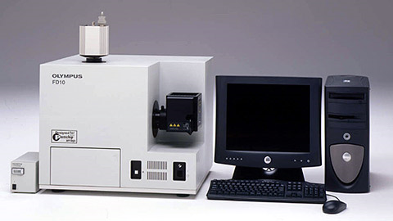
Microarray
Microarrays can test 10,000 genes at a time, with each gene attached to a specific site in the array. They laser reads the array and the results are analyzed by computer.

Slide 10
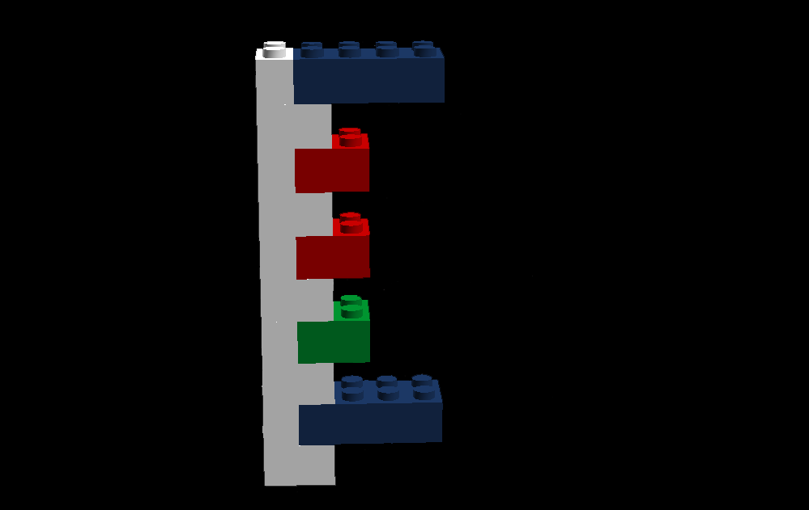
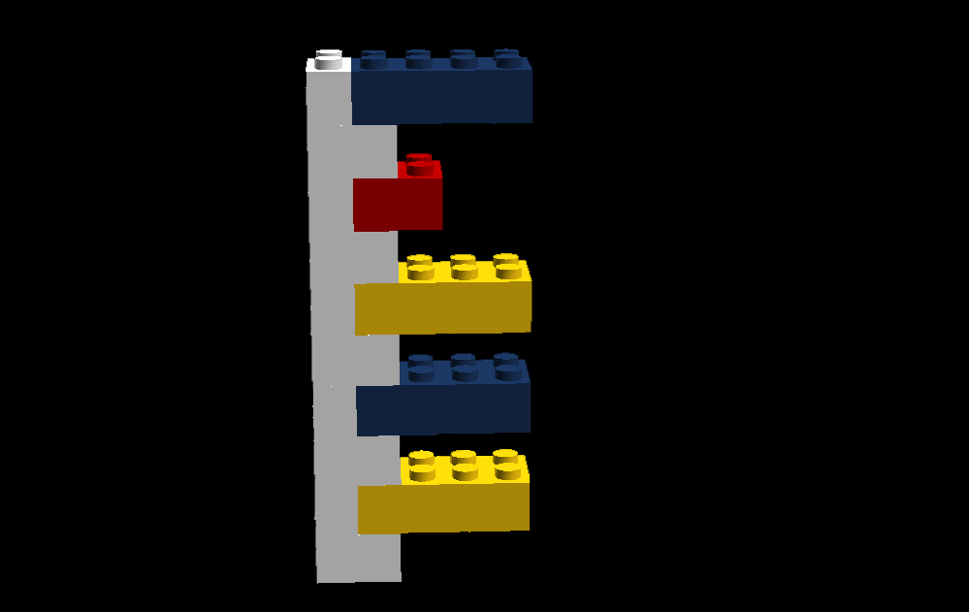
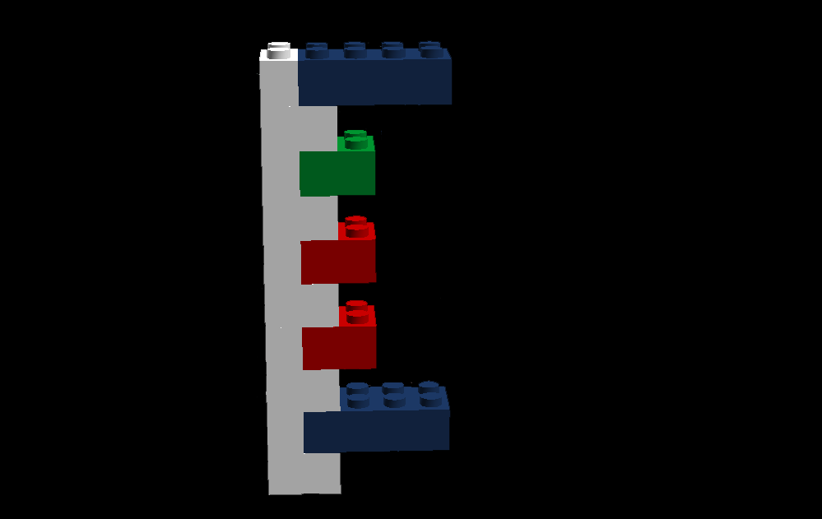
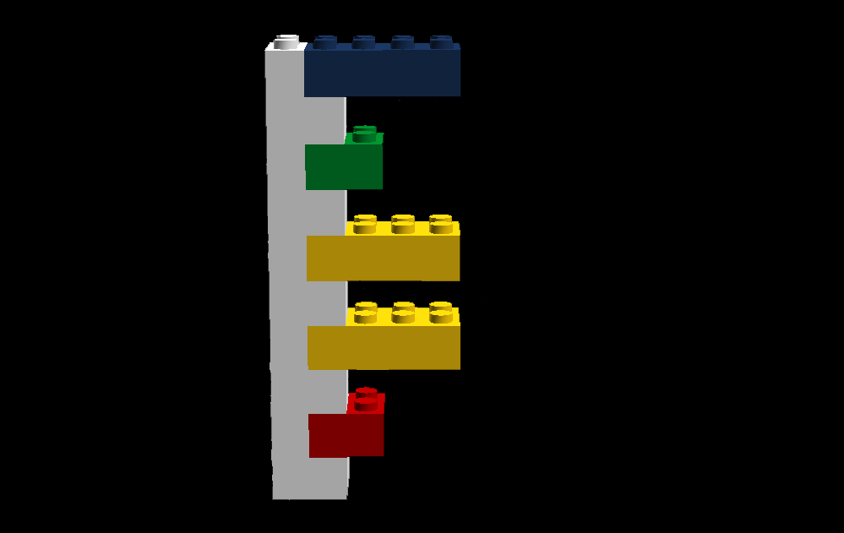
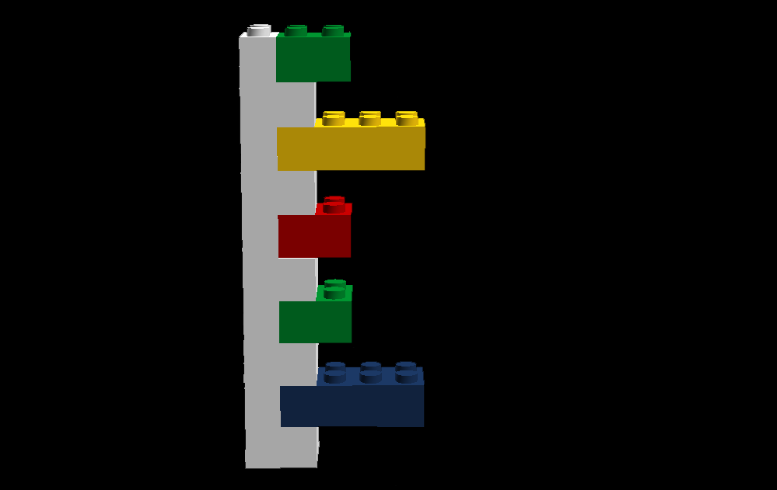
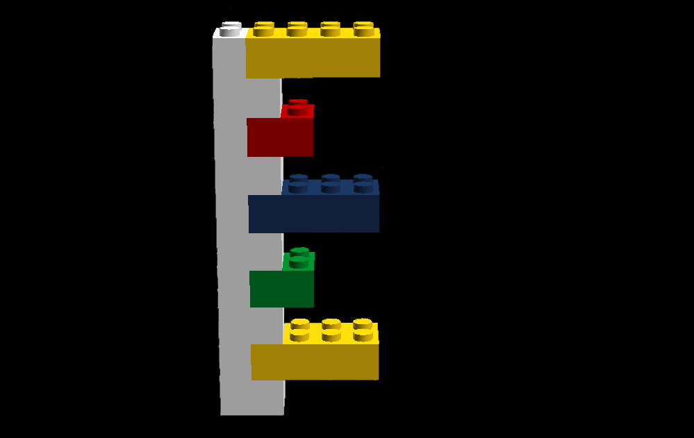
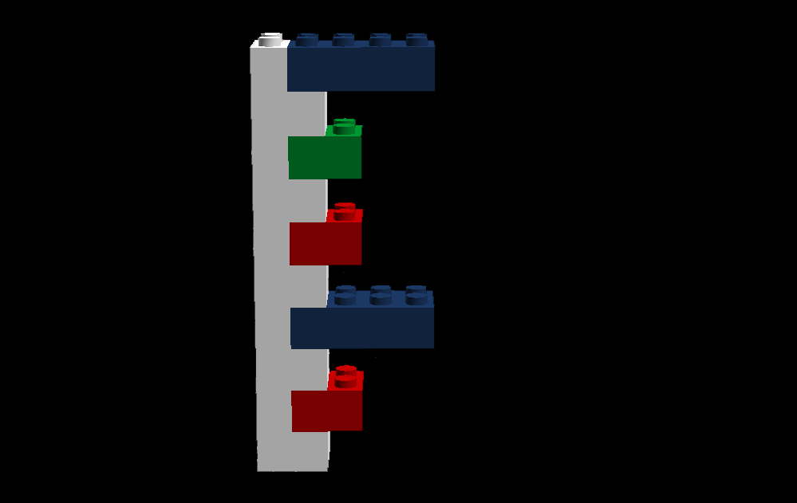
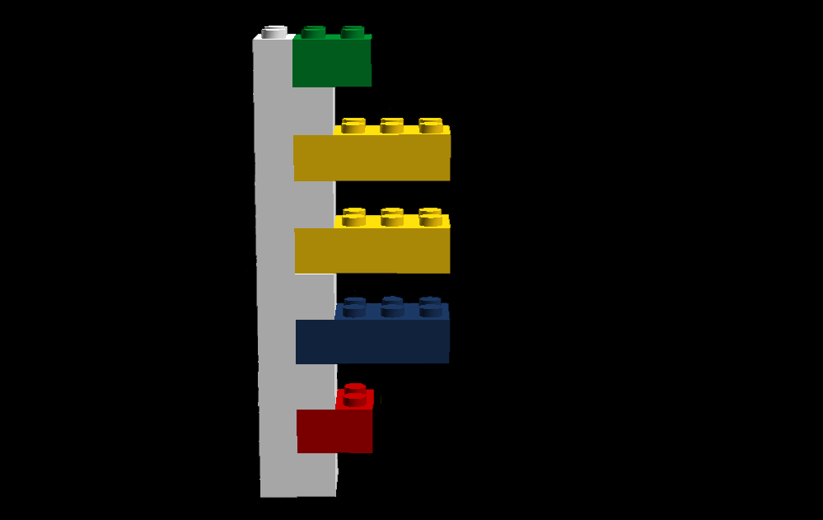
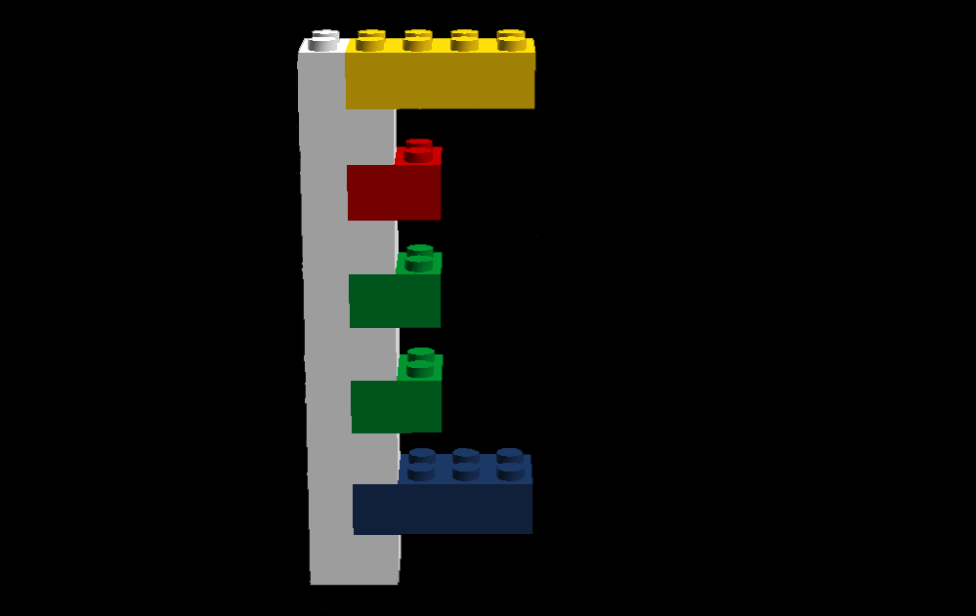
Microarray
Blue
Green
Brown
Cleft
Widow’s Peak
Female
No Cleft
No Peak
Male

Slide 11
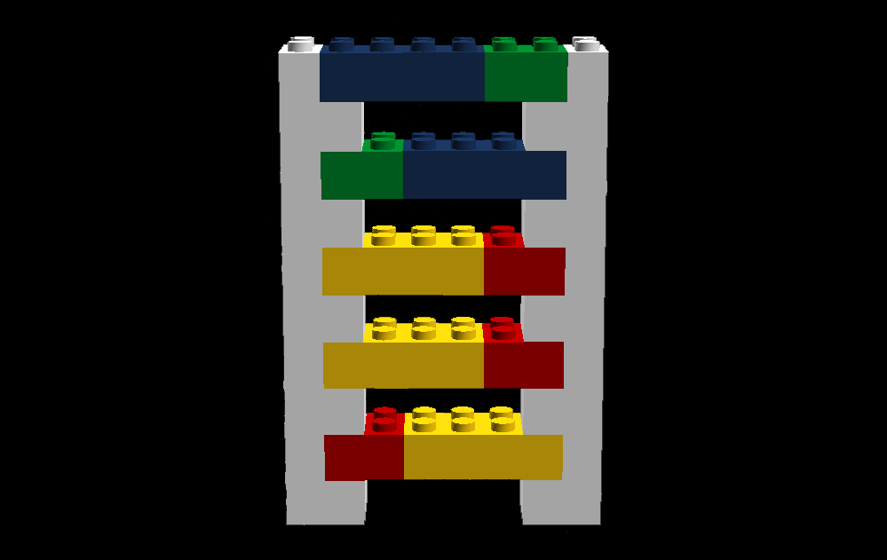
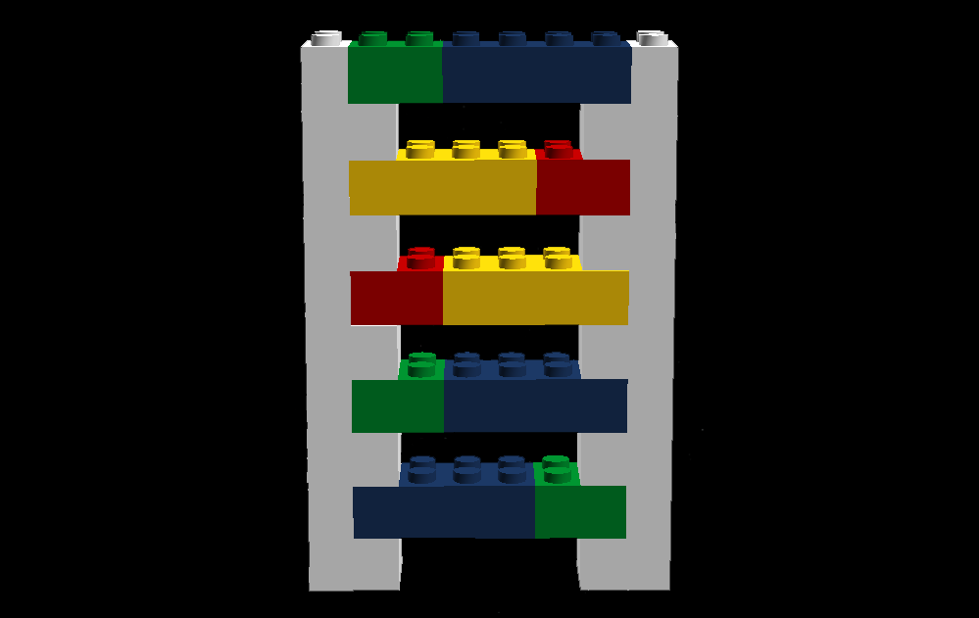
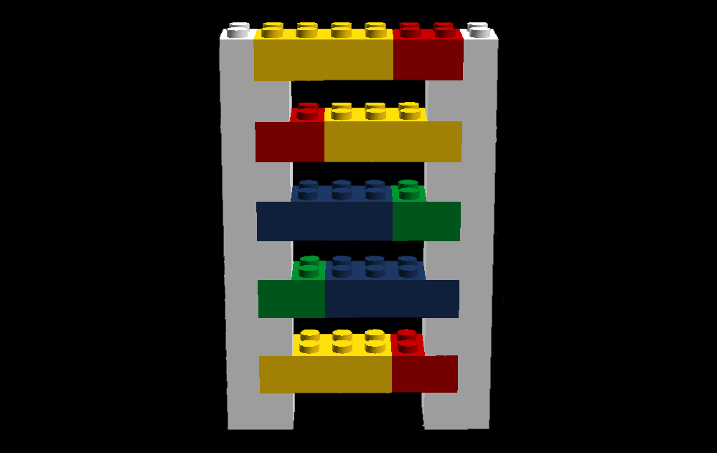
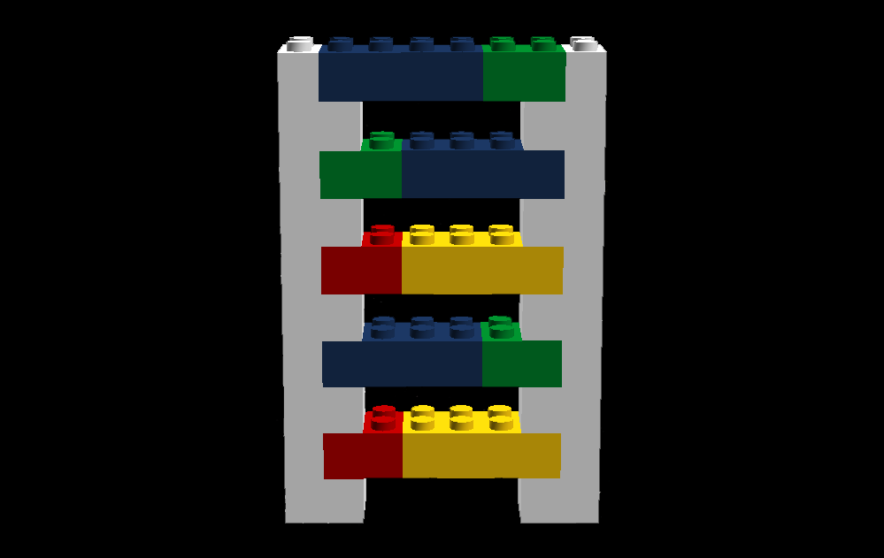
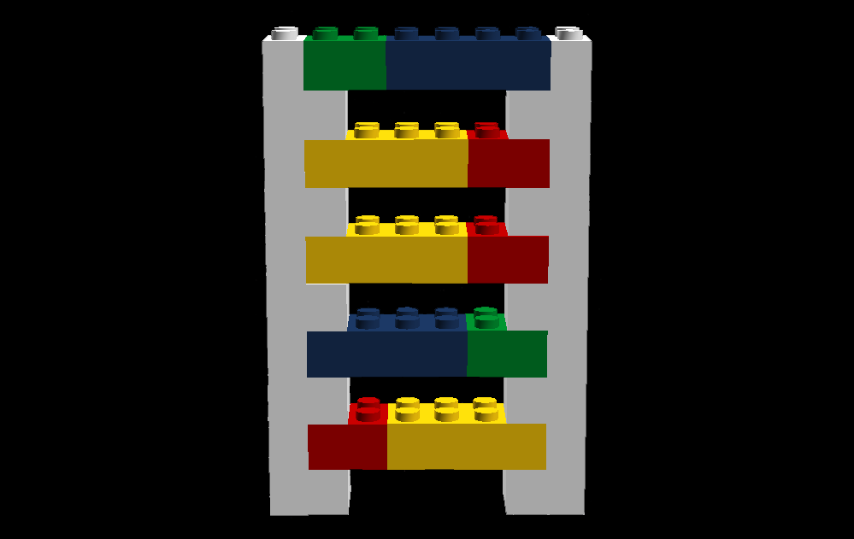
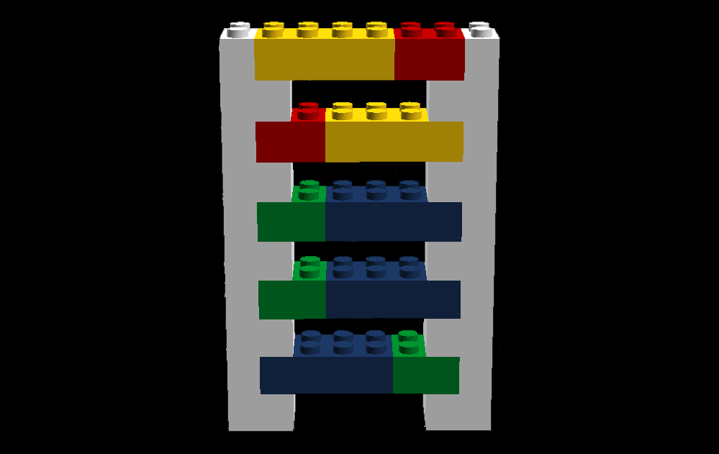
Build Your Microarray
Blue
Green
Brown
Cleft
Widow’s Peak
Female
No Cleft
No Peak
Male

Slide 12
Using A Microarray
What genes does the suspect have? How do you know?
Why does one side of a gene only match up with their partner?
Who does your microarray implicate? How do you know?
Why would a real microarray, with the real procedure, be more accurate than what we did?

